Slide 1
World War I
and the Creation of the Modern World
Dr. Kevin Gannon
Director, Center for Excellence in Teaching & Learning and Professor of History
Grand View University
kgannon@grandview.edu
@TheTattooedProf

Slide 2
How do we remember World War I?
Why?

Slide 3
In What Ways is World War I Relevant to Today’s World?

Slide 4
The European Powderkeg
Nationalism and Imperialism as Forces of Aggression
Secret Diplomacy: A Network of Hidden Alliances
Gavrilo Princip and Archduke Franz Ferdinand: June 28, 1914
The “Guns of August”

Slide 5
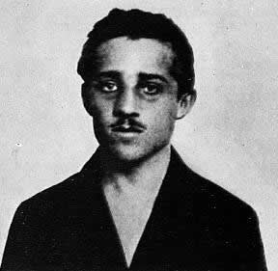
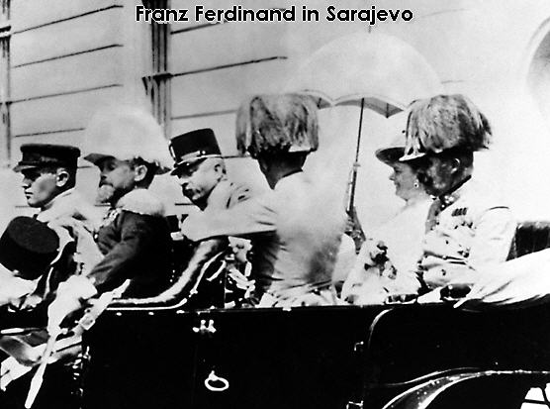

Slide 6
Notes:
Bridge in Sarajevo where Archduke Franz Ferdinand was assassinated.

Slide 7
The Belligerents
Allies - Initially composed of Britain, France, Belgium, and Russia, and would eventually total eighteen nations, including Italy and the United States.
Central Powers - Initially Germany and Austria-Hungary, expanded by 1915 to include the Ottoman Empire and Bulgaria.

Slide 8
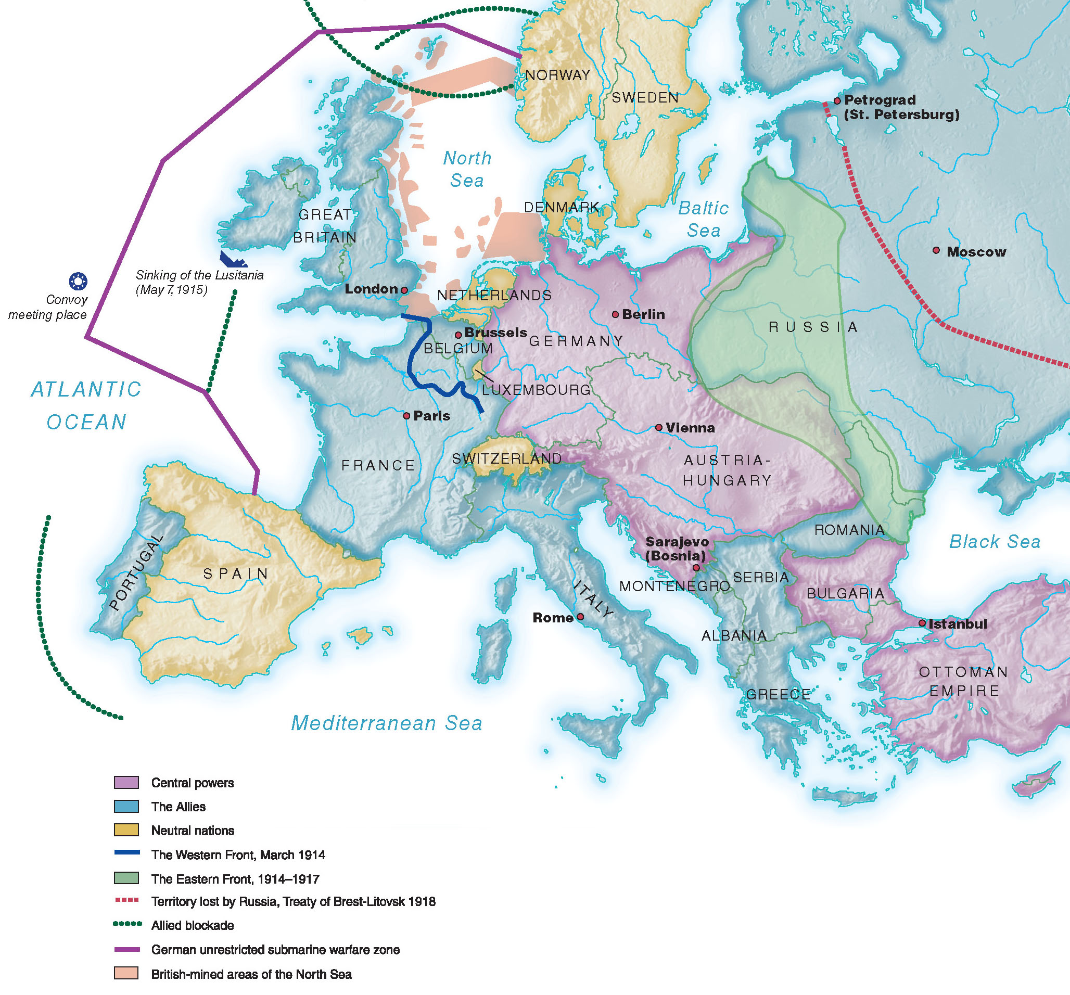
Notes:
20.1 World War I in Europe, 1914–1918
Miscalculations led to a two-front war for Germany and the creation of the Western Front in 1914, while the war at sea eventually drew the United States
into the conflict.

Slide 9
The War in Europe
The Schlieffen Plan - A military plan that called for Germany to attack and quickly defeat France while the cumbersome Russian army mobilized.
Western Front - Complex system of trenches and earthworks that ran for 550 miles from the North Sea to Switzerland.
Eastern Front – More mobile, harsher environment along the Russian border.

Slide 10
The Global War
Imperial Surrogates – Native Soldiers and Colonial Officers: Ramifications for Imperialism
Africa and the Middle East – A continuation and extension of imperial competition
The Naval Struggle – Blockades and U-Boats

Slide 11
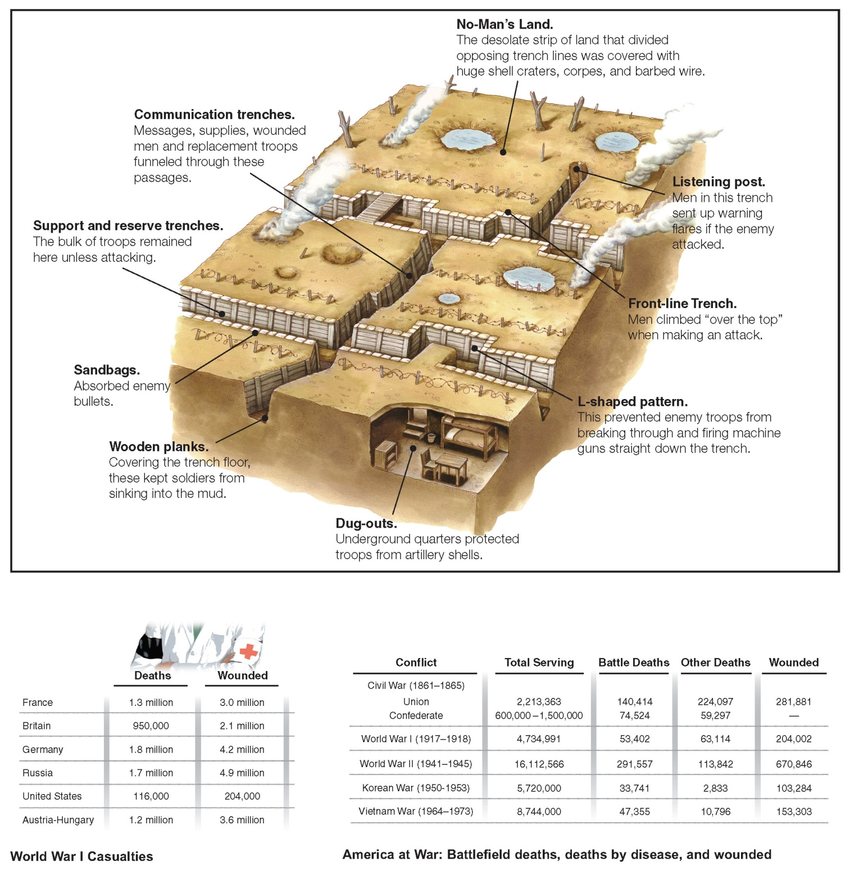
Notes:
World War I

Slide 13
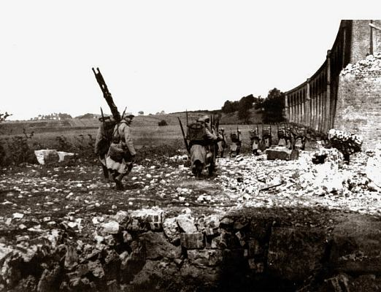
Notes:
French Soldiers at Alsace-Lorraine

Slide 14
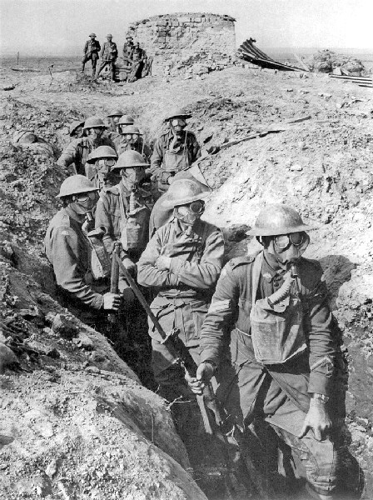

Slide 15
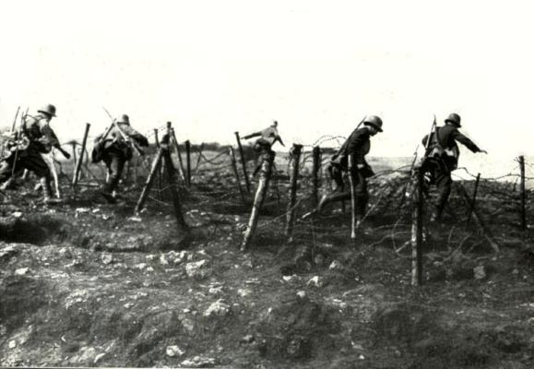
Notes:
German soldiers navigating barbed wire

Slide 16
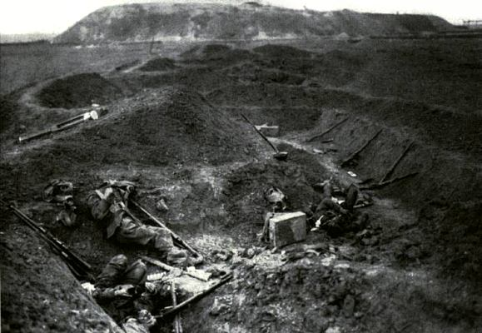
Notes:
German trench after battle

Slide 17
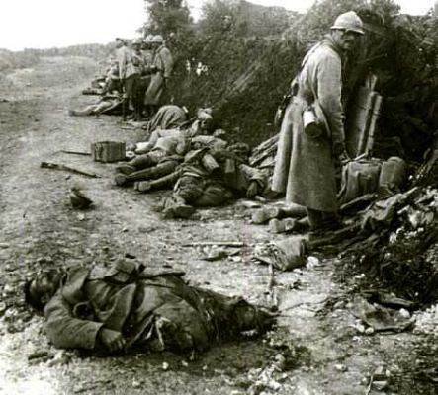
Notes:
After the Battle of Verdun

Slide 18
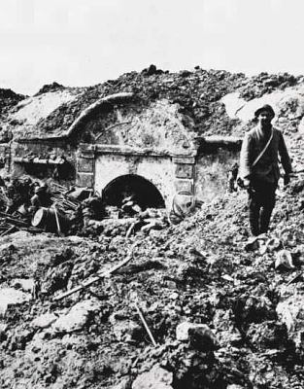
Notes:
Aftermath at Verdun

Slide 19
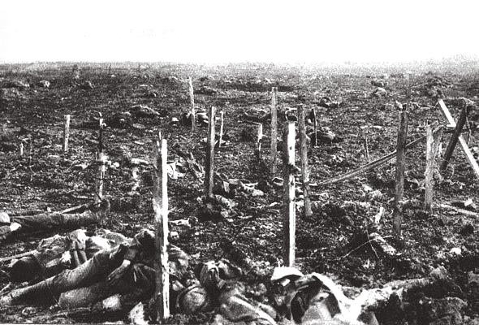
Notes:
British War Dead

Slide 20
The Perils of Neutrality
U-boats & Unrestricted Submarine Warfare
Lusitania - British passenger ship sunk by a German U-boat on May 7, 1915, an attack that killed 1,198 passengers, including 128 Americans.

Slide 21
Notes:
20.3 U.S. Exports to Europe, 1914–1917
The nation’s robust trade with Britain, France, and Italy—allied nations fighting Germany—provoked debate among Americans holding conflicting
visions of neutrality.

Slide 22
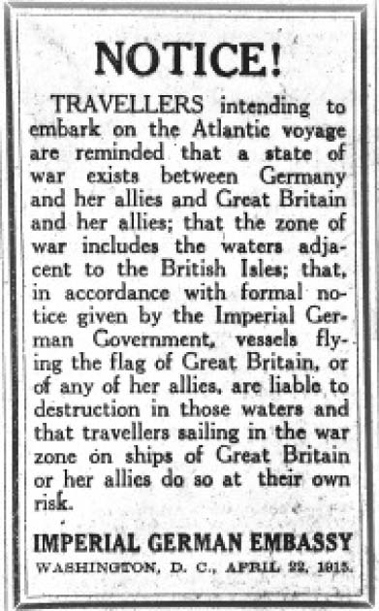
Notes:
20.5 German Warning to Travelers in the War Zone
When Wilson criticized Germany for sinking the Lusitania, German Americans pointed out that the German government had published warnings like this ahead of time urging Americans to stay off ships headed to the war zone.

Slide 23
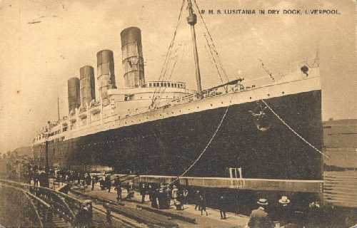

Slide 24
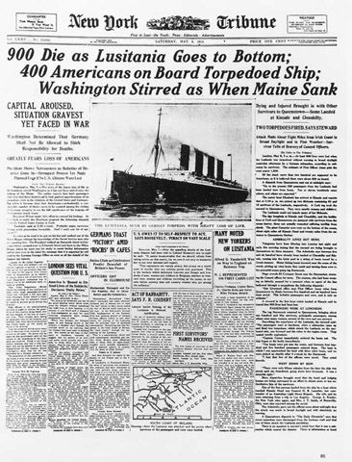

Slide 25
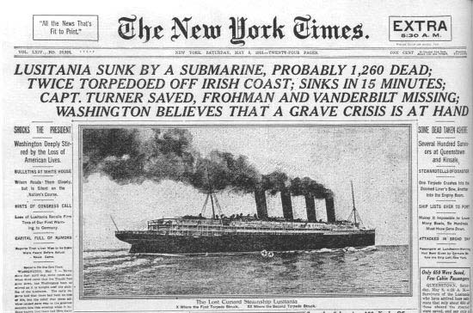

Slide 26
America Enters the War
Wilson Tries to Avoid War
Ultimatums to Germany
The Election of 1916
“Peace Without Victory?”
The Resumption of Unrestricted Submarine Warfare
Zimmermann Telegram

Slide 27
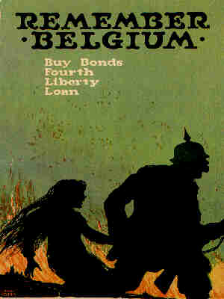

Slide 28
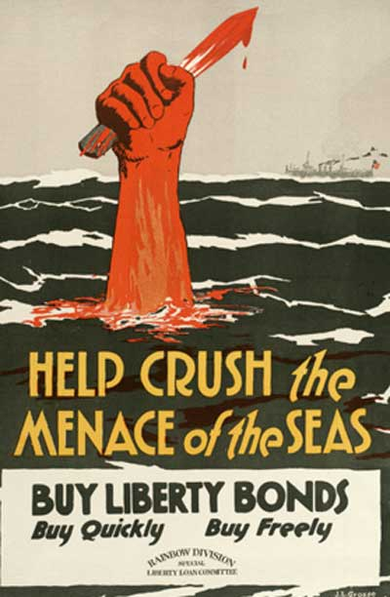

Slide 29
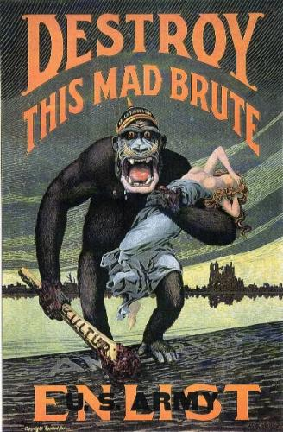

Slide 30
The Peace that Wasn’t
Wilson’s Fourteen Points – “Making the World Safe For Democracy?”
Self Determination and Open Diplomacy
Imperialism and Idealism
Sources of Friction
The Treaty of Versailles & Legacies of the War

Slide 31
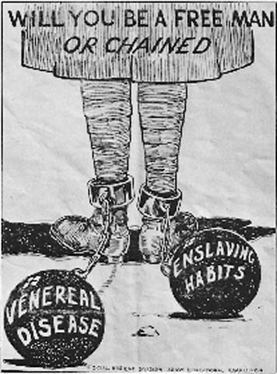

Slide 33
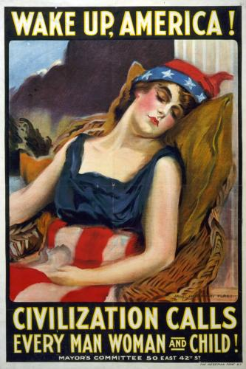

Slide 34
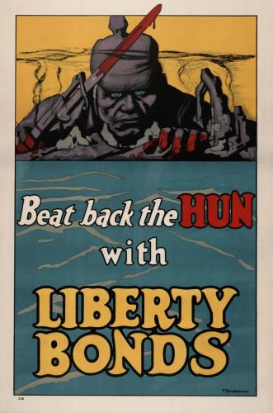

Slide 36
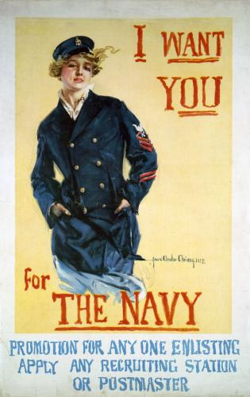

Slide 37
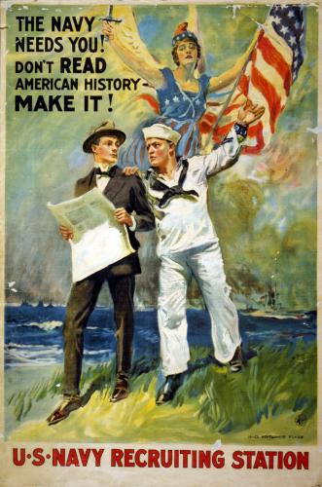

Slide 38
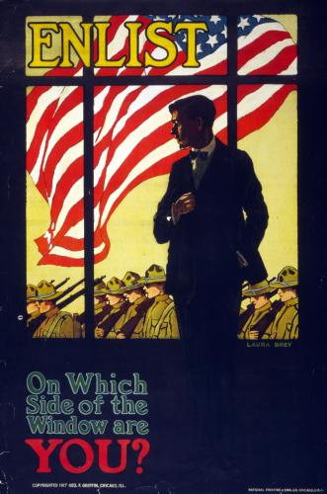

Slide 39
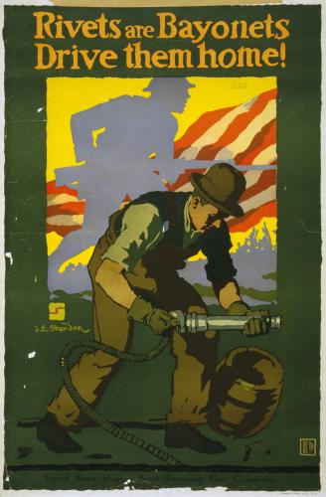

Slide 45
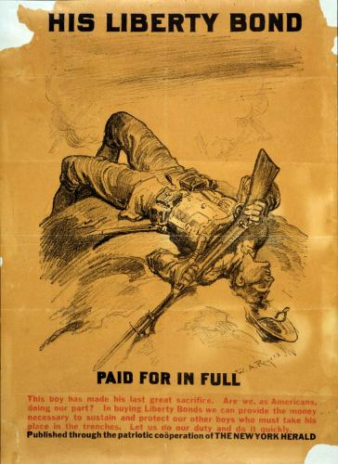

Slide 46
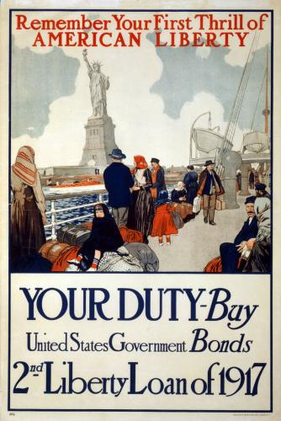

Slide 47
