Slide 1
What’s in Your Pocket?

Slide 2
The Assassination of President Lincoln
Currier & Ives. "The assassination of President Lincoln: at Ford's Theatre, Washington, D.C., April 14th, 1865," n.d. Prints and Photographs Division, Library of Congress. Reproduction Number LC-USZ62-2073 DLC.

Slide 3
Petersen Boarding House
Lincoln's last hour.[n. p., 1865?] Stern Collection, Rare Book and Special Collections Division.

Slide 4
Items in President Lincoln's pocket the night he was assassinated.
"Contents of Abraham Lincoln's Pockets." April 14, 1865. American Treasures of the Library of Congress.

Slide 5
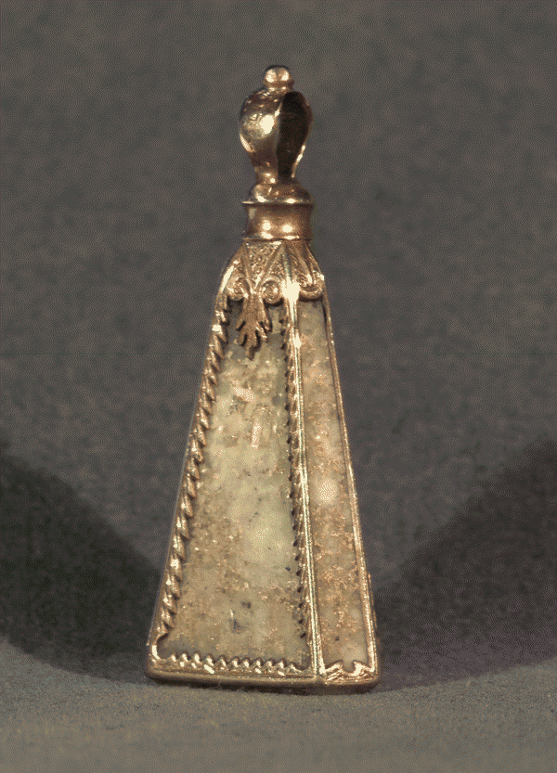
Watch Fob http://memory.loc.gov/cgi-bin/ampage?collId=lprbscsm&fileName=scsm1049/lprbscsmscsm1049.db&recNum=0

Slide 6
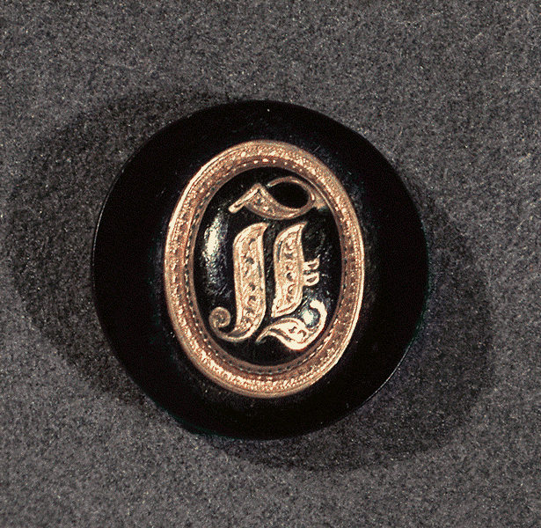
Button http://memory.loc.gov/cgi-bin/ampage?collId=lprbscsm&fileName=scsm1049/lprbscsmscsm1049.db&recNum=1

Slide 7
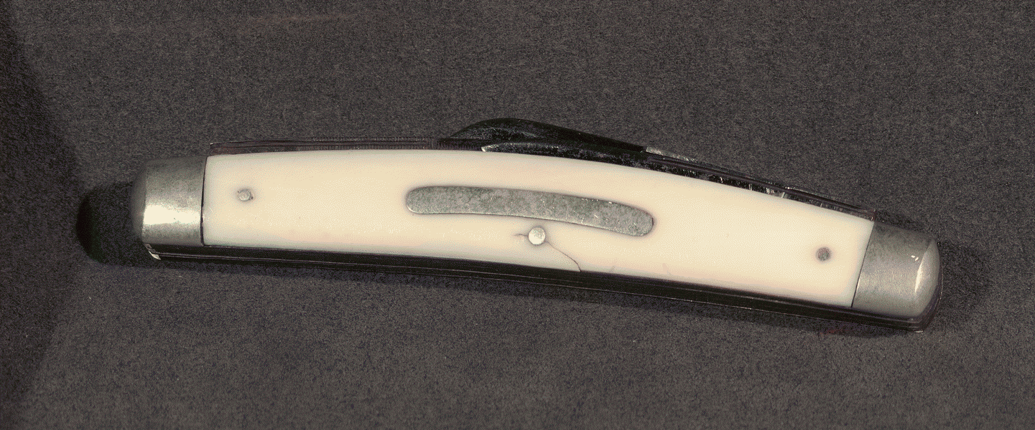
Pocket Knife http://memory.loc.gov/cgi-bin/ampage?collId=lprbscsm&fileName=scsm1049/lprbscsmscsm1049.db&recNum=2

Slide 8
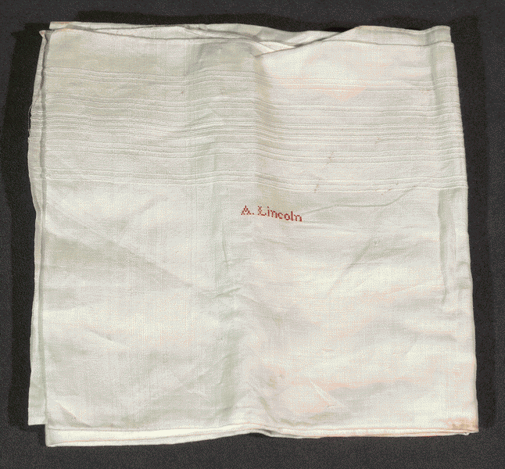
Handkerchief http://memory.loc.gov/cgi-bin/ampage?collId=lprbscsm&fileName=scsm1049/lprbscsmscsm1049.db&recNum=3

Slide 9
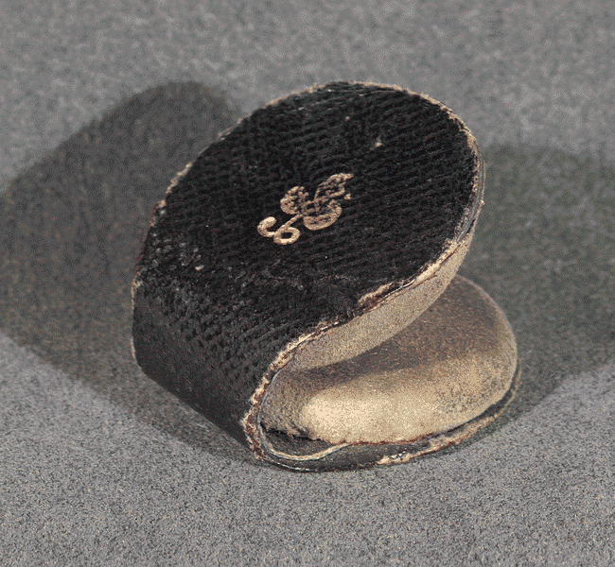
Glass Lens polisher http://memory.loc.gov/cgi-bin/ampage?collId=lprbscsm&fileName=scsm1049/lprbscsmscsm1049.db&recNum=6

Slide 10
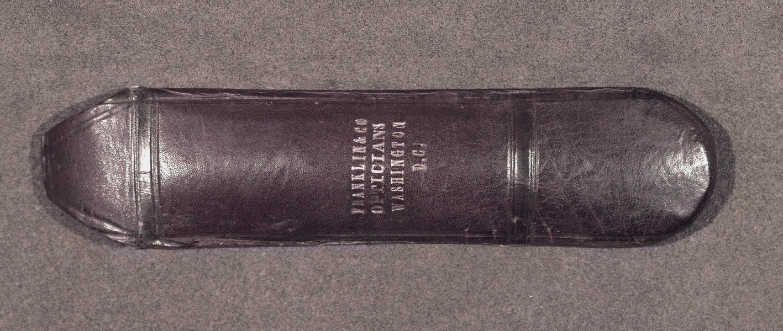
Glasses Case http://memory.loc.gov/cgi-bin/ampage?collId=lprbscsm&fileName=scsm1049/lprbscsmscsm1049.db&recNum=7

Slide 11
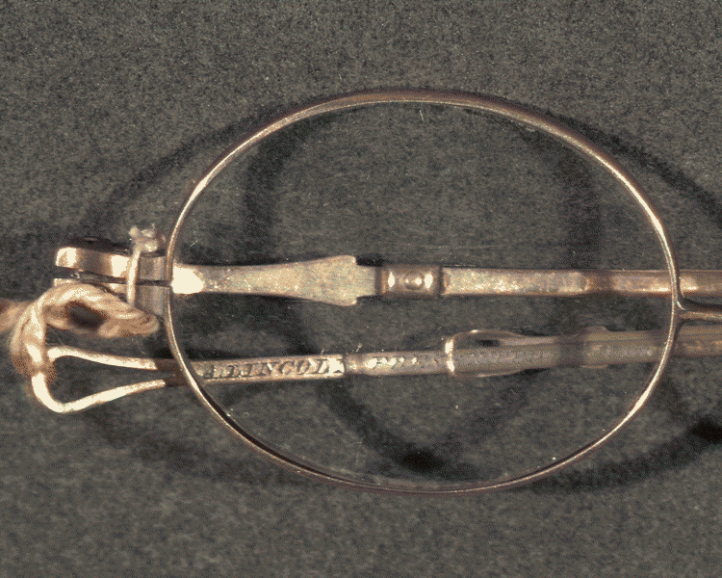
Eyeglasses http://memory.loc.gov/cgi-bin/ampage?collId=lprbscsm&fileName=scsm1049/lprbscsmscsm1049.db&recNum=8

Slide 12
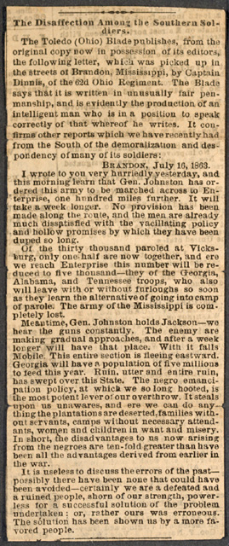
Newspaper clippings http://www.loc.gov/exhibits/treasures/images/vc50e.1b.jpg

Slide 13
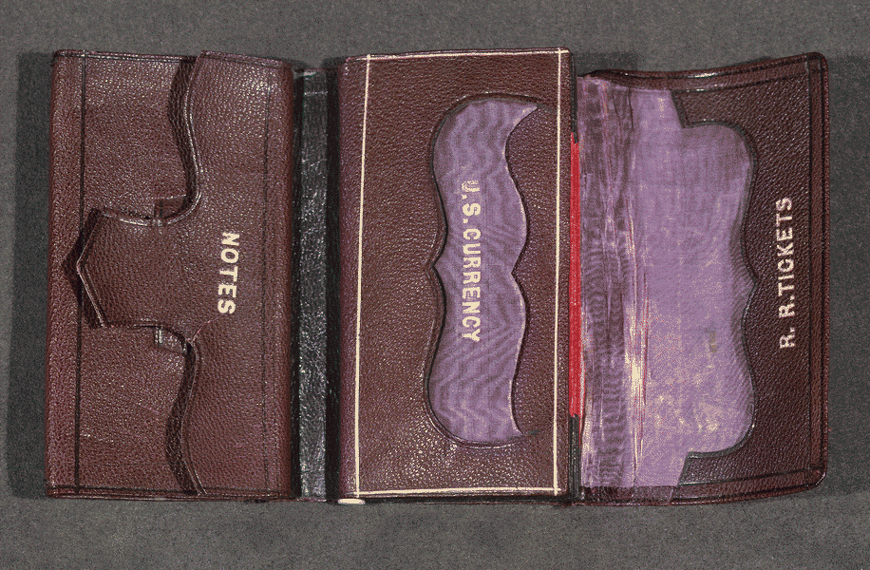
Wallet http://memory.loc.gov/cgi-bin/ampage?collId=lprbscsm&fileName=scsm1049/lprbscsmscsm1049.db&recNum=4

Slide 14
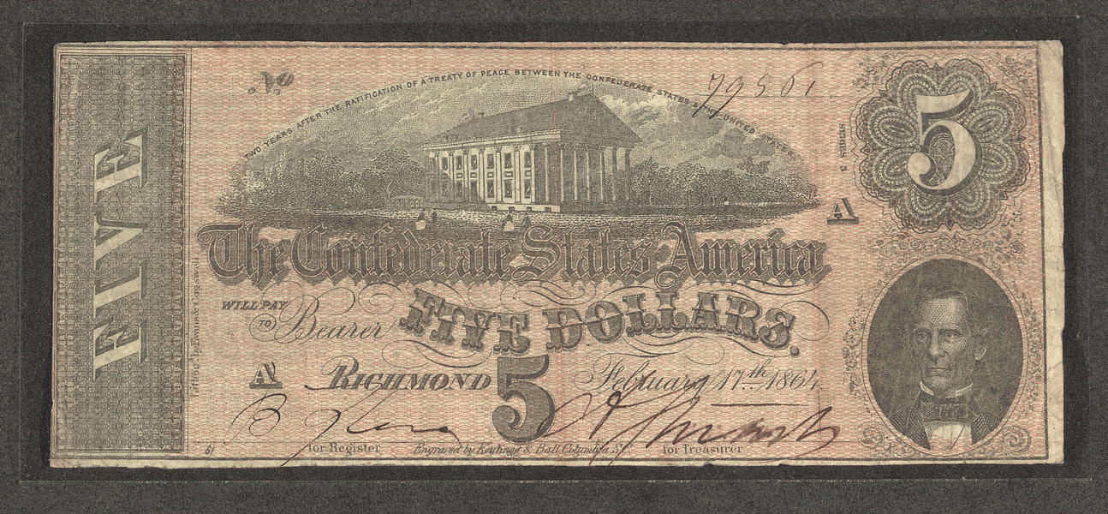
Confederate $5 Bill http://memory.loc.gov/cgi-bin/ampage?collId=lprbscsm&fileName=scsm1049/lprbscsmscsm1049.db&recNum=5

Slide 15
Examining Primary Sources

Slide 16
References:
"Contents of Abraham Lincoln's Pockets." April 14, 1865. American Treasures of the Library of Congress.
Currier& Ives. “The assassination of President Lincoln: at Ford’s Theatre, Washington, D.C., April 14th, 1865,” n.d. Prints and Photographs Division, Library of Congress. Reproduction Number LC-USZ62-2073 DCLC.
Goodwin, D. K., Team of Rivals: The Political Genius of Abraham Lincoln. Simmon & Schuster (2005)
Hambly, B. The Emancipator’s Wife: A Novel of Mary Todd Lincoln, Bantam Books, 2005
“Lincoln's last hour.”[n. p., 1865?] Stern Collection, Rare Book and Special Collections Division.
O’Reilly, B., Dugard, M., Killing Lincoln: The Shocking Assassination that Changed America Forever. Holt, Henry & Company, Inc. (2011).
Swanson, J.L., Manhunt: The 12-Day Chase for Lincoln’s Killer. William Morrow, 2006

