Slide 1
Teaching with Primary Sources at Illinois State University
Funded by the Library of Congress

Slide 2
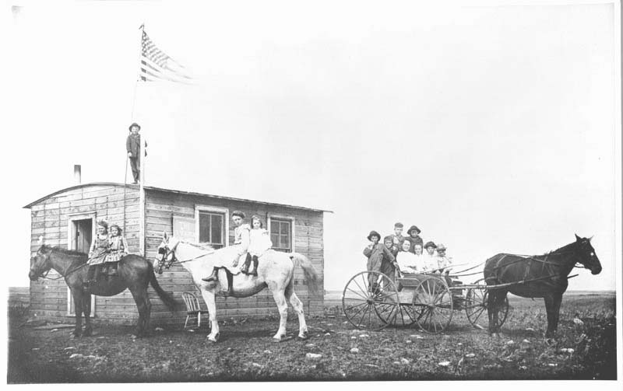
Fred Hultstrand History in Pictures Collection, NDIRS-NDSU, Fargo.

Slide 3
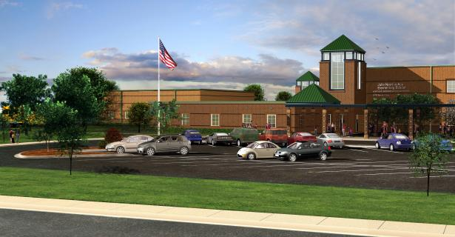
Northside ISD Central Office5900 Evers Rd. San Antonio, TX 78238. 7 March 2013. http://www.nisd.net/schools/info/178

Slide 5
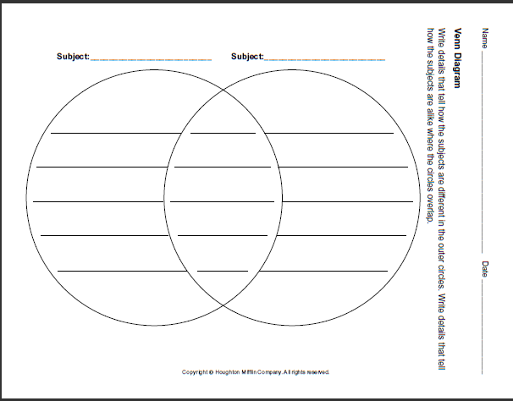

Slide 6
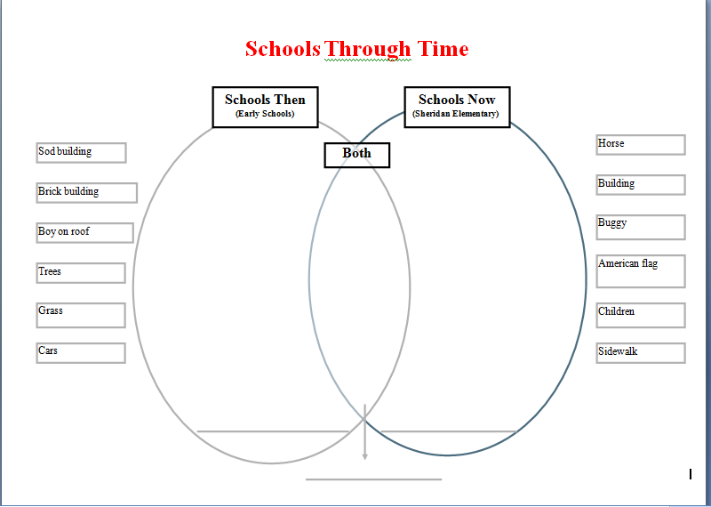

Slide 7
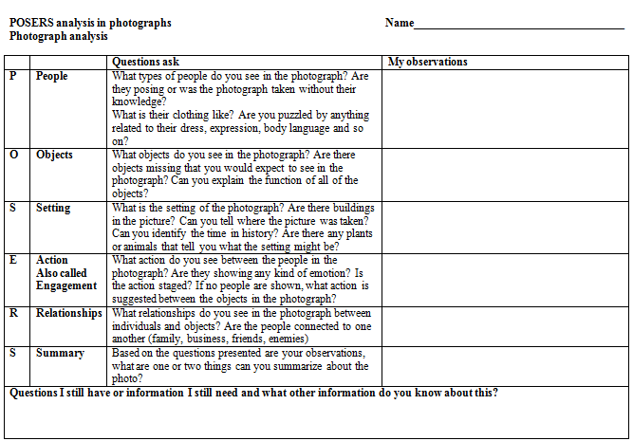

Slide 8
a.Key Ideas and Details (cont) Make logical inferences∙ Support conclusions drawn from the text ∙ Determine central ideas or themes of a text and analyze their development
a. Key Ideas and Details Read closely to determine what the text says explicitly ∙ Cite specific textual evidence ∙ Summarize the key supporting details and ideas
c. Integration of Knowledge and Ideas Analyze how and why individuals, events and ideas develop and interact over the course of a text
b. Craft and Structure Interpret words and phrases as they are used in text ∙ Analyze how specific word choices shape meaning or tone ∙ Analyze the structure of texts ∙ Assess how point of view or purpose shapes the content and style of text
Integration of Knowledge and Ideas (cont)Integrate and evaluate content presented in diverse formats ∙ Delineate and evaluate the argument and specific claims ∙ Analyze how two or more texts address similar themes to build knowledge or to compare the approaches the authors take

Slide 9
Connection to the Common Core
CCSS.ELA-Literacy.RI.K.1With prompting and support, ask and answer questions about key details in a text.
CCSS.ELA-Literacy.RI.K.9With prompting and support, identify basic similarities in and differences between two texts on the same topic (e.g., in illustrations, descriptions, or procedures).
CCSS.ELA-Literacy.RI.1.1Ask and answer questions about key details in a text.
CCSS.ELA-Literacy.RI.1.9Identify basic similarities in and differences between two texts on the same topic (e.g., in illustrations, descriptions, or procedures).
CCSS.ELA-Literacy.RI.2.1Ask and answer such questions as who, what, where, when, why, and how to demonstrate understanding of key details in a text.
CCSS.ELA-Literacy.RI.2.9Compare and contrast the most important points presented by two texts on the same topic.

Slide 10
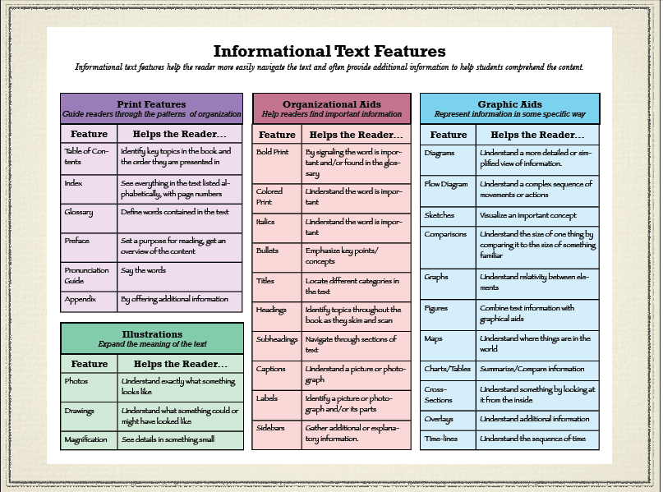
What is Informational Text?
http://t4.jordan.k12.ut.us/cbl/images/litfac/binfo.pdf

Slide 11
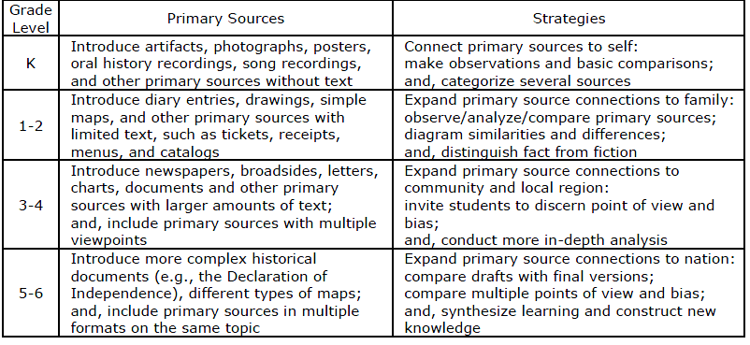

Slide 12
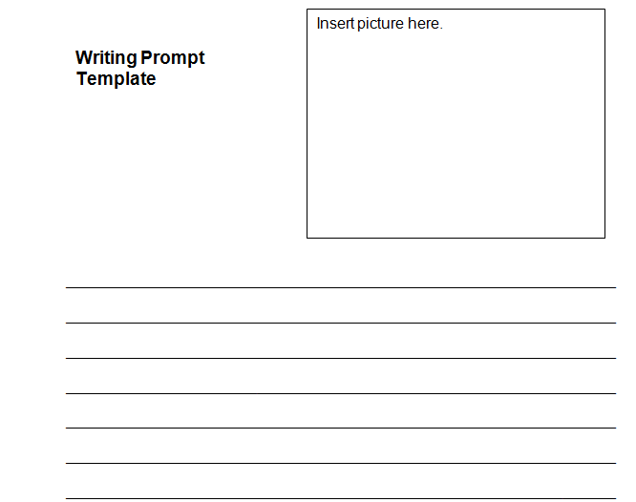
Writing Prompt
________________________________________________________________________________________________________________________________________________________________________________________________________________________________________________________________________________________________

Slide 13
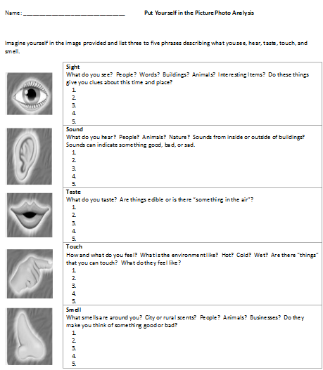

Slide 15
School House Photo Story

