Slide 1
Creating Book Backdrops
TPS Program at Illinois State University
Funded by the Library of Congress

Slide 2
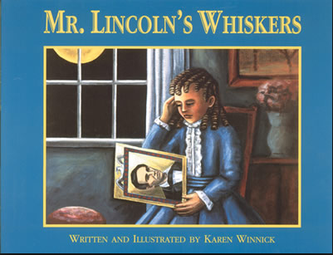
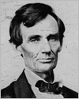
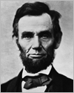
Book Backdrops: Bringing Historical Fiction to Life with Primary Sources
Mr. Lincoln’s Whiskers by Karen Winnick
http://foreverlearning.wikispaces.com/file/view/mrLincolnsWhiskers.pdf

Slide 3
Creating Book Backdrops Six Step Process
Content: Select a topic(s) you will be studying in your classroom. Check your state and local school district standards and curriculum guides for content and skills suggestions.
Learning Objective: Determine what you want students to learn from working with the primary sources associated with the book you select. What is the enduring understanding?
Book Selection: Choose a book that aligns with your topic and is appropriate for your grade level.
Read: As you read the book, compile a list of dates, people and events that might have primary source connections.
Primary Sources: Search across loc.gov for primary source items that connect with your book.
Teaching Strategies: Determine how you will incorporate the primary sources into your lessons.

Slide 4
Common Core State Standards
CCSS.ELA-Literacy.RI.3.1 Ask and answer questions to demonstrate understanding of a text, referring explicitly to the text as the basis for the answers.
CCSS.ELA-Literacy.RI.3.2 Determine the main idea of a text; recount the key details and explain how they support the main idea.
CCSS. ELA-Literacy.RI.3.7 Use information gained from illustrations (e.g., maps photographs) and the words in a text to demonstrate understanding of the text (e.g., where, when, why, and how key events occur).
CCSS.ELA-Literacy.RI.3.10 By the end of the year, read and comprehend informational texts, including history/social studies, science, and technical texts, at the high end of the grades 2-3 text complexity band independently and proficiently.
CCSS.ELA-Literacy.RI.3.3 Describe the relationship between a series of historical events, scientific ideas or concepts, or steps in technical procedures in a text, using language that pertains to time, sequence, and cause/effect.
CCSS.ELA-Literacy.RL.3.3 Describe characters in a story (e.g., their traits, motivations, or feelings) and explain how their actions contribute to the sequence of events.
CCSS.ELA-Literacy.RL.3.5 Refer to parts of stories, dramas, and poems when writing or speaking about a text, using terms such as chapter, scene, and stanza; describe how each successive part builds on earlier sections

Slide 5
Content
Analyzing Primary Sources
Presidents
Elections/Voting Process
Letter Writing
Editing

Slide 6
Learning Objectives
Students will relate in a personal way to events of the past and promote a deeper understanding of history as a series of human events through analyzing primary sources.
Students will read first-person accounts of events to help make them more real, fostering active reading and response.

Slide 7
Book Selection

Slide 8
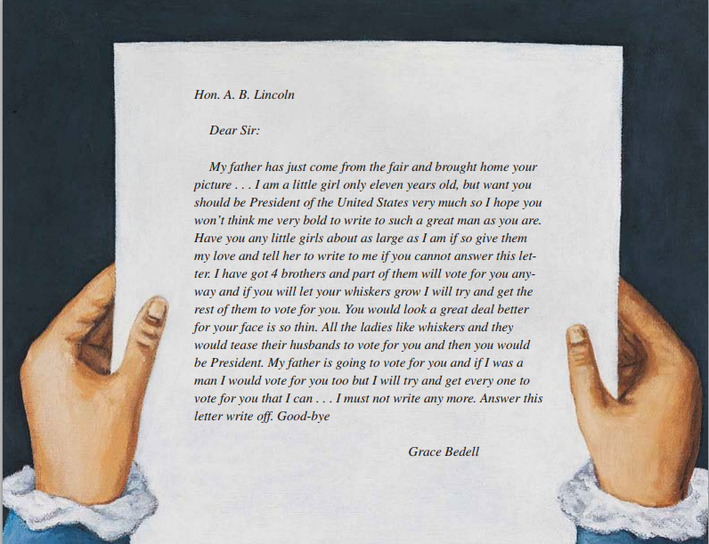
Read
http://foreverlearning.wikispaces.com/file/view/mrLincolnsWhiskers.pdf
http://www.karenbwinnick.com/audio/lincoln.mp3

Slide 9
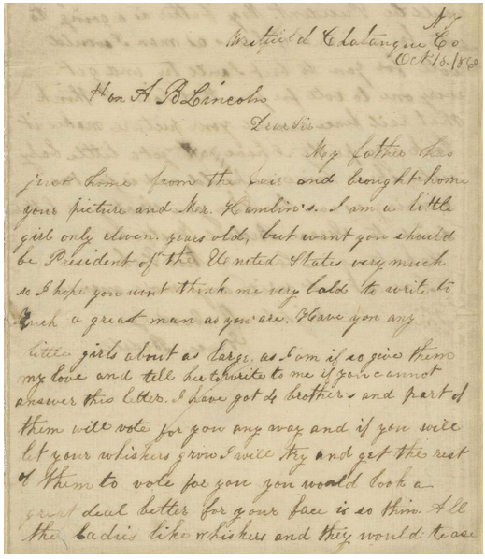
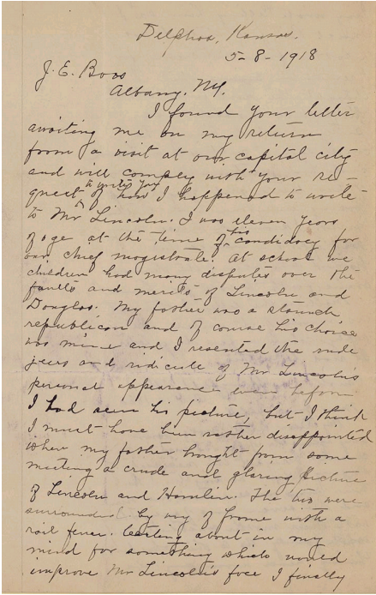
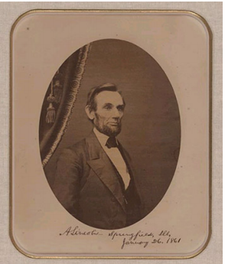
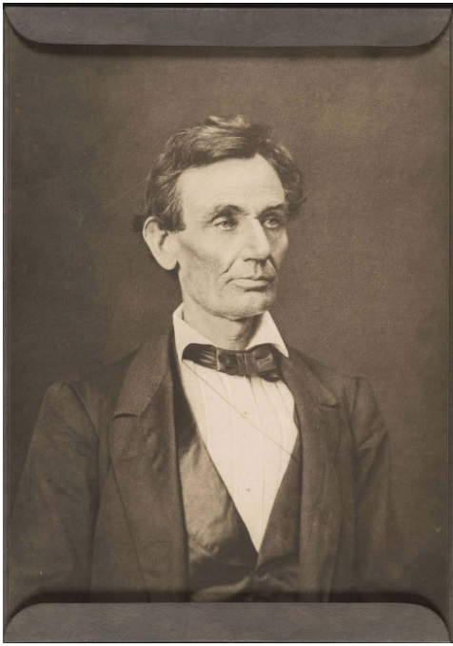
Primary Sources

Slide 10
Teaching Strategies
Compare and contrast images of the same event by different artist
Create a book gallery – display the book (or cover) with primary source connections and student statements
Create a timeline with primary sources related to happenings in the book.
Write captions or headlines. Select an image depicting one or more people. Have students write an attention-getting phrase to accompany each image.

Slide 11
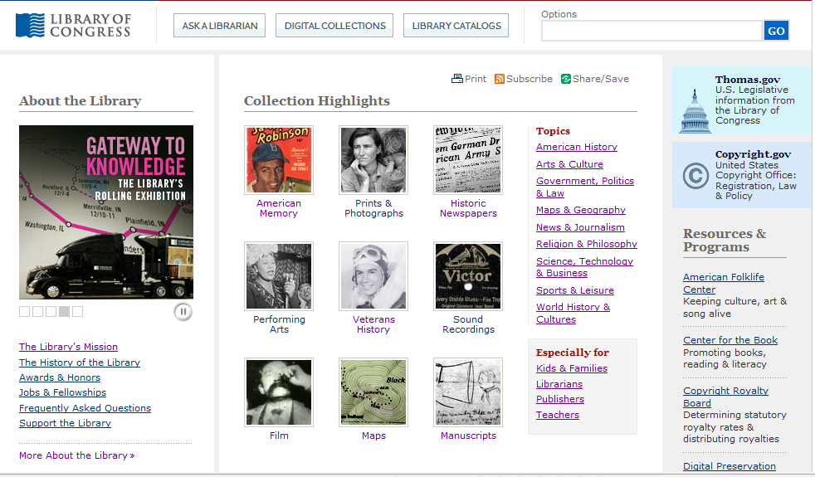
Library of Congress http://www.loc.gov

Slide 12
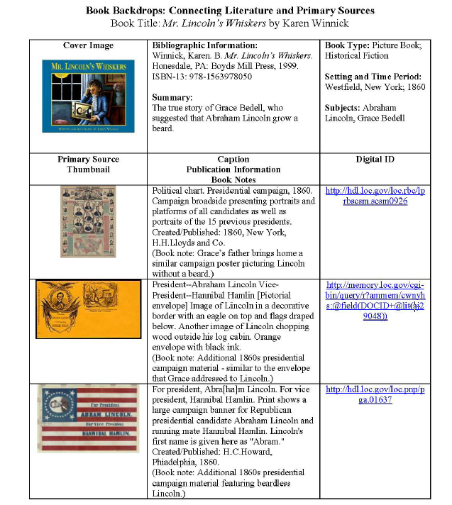

Slide 13
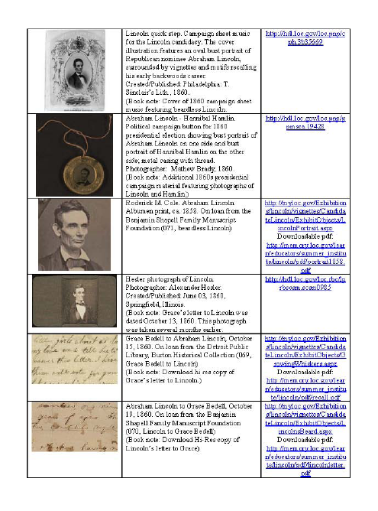
a. Key Ideas and Details (cont) Make logical inferences∙ Support conclusions drawn from the text ∙ Determine central ideas or themes of a text and analyze their development
a. Key Ideas and Details Read closely to determine what the text says explicitly ∙ Cite specific textual evidence ∙ Summarize the key supporting details and ideas
c. Integration of Knowledge and Ideas Analyze how and why individuals, events and ideas develop and interact over the course of a text
b. Craft and Structure Interpret words and phrases as they are used in text ∙ Analyze how specific word choices shape meaning or tone ∙ Analyze the structure of texts ∙ Assess how point of view or purpose shapes the content and style of text
Integration of Knowledge and Ideas (cont)Integrate and evaluate content presented in diverse formats ∙ Delineate and evaluate the argument and specific claims ∙ Analyze how two or more texts address similar themes to build knowledge or to compare the approaches the authors take

Slide 14
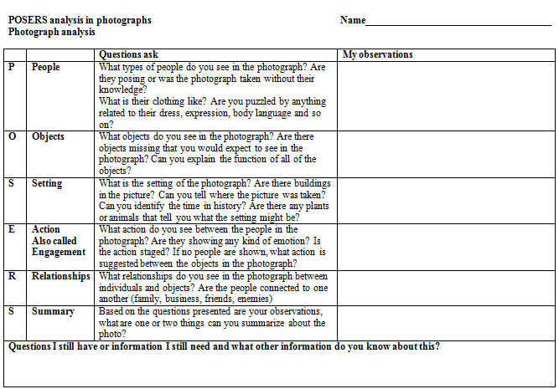

Slide 15
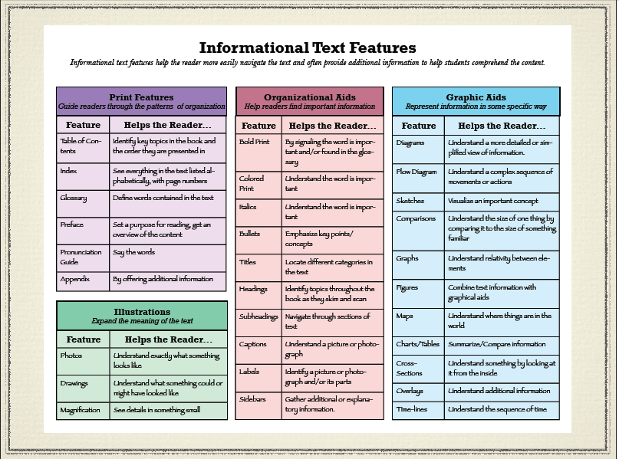
What is Informational Text?
http://t4.jordan.k12.ut.us/cbl/images/litfac/binfo.pdf

Slide 16
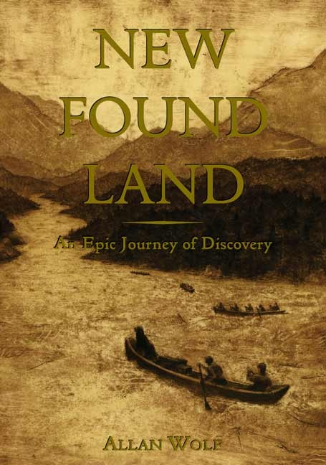
Summary: This novel in verse highlights letters and thoughts of Jefferson, the Corps of Discovery, Sacagawea and Lewis’s Newfoundland dog Seaman as they travel on their expedition to seek a water route to the Pacific.
Setting: North America, 1803 – 1819
A Sampling of Library of Congress Resources:
Fill Up the Canvas (Activity) http://www.loc.gov/teachers/classroommaterials/presentationsandactivities/presentations/lewisandclark/
Rivers, Edens, Empires (Exhibition) http://www.loc.gov/exhibits/lewisandclark/lewisandclark.html
The Thomas Jefferson Papers
http://memory.loc.gov/ammem/collections/jefferson_papers/
Map Collections: Discovery and Exploration http://memory.loc.gov/ammem/gmdhtml/dsxphome.html
Wolf, Allan. New Found Land: A Novel. Cambridge, MA: Candlewick, 2004.

Slide 17
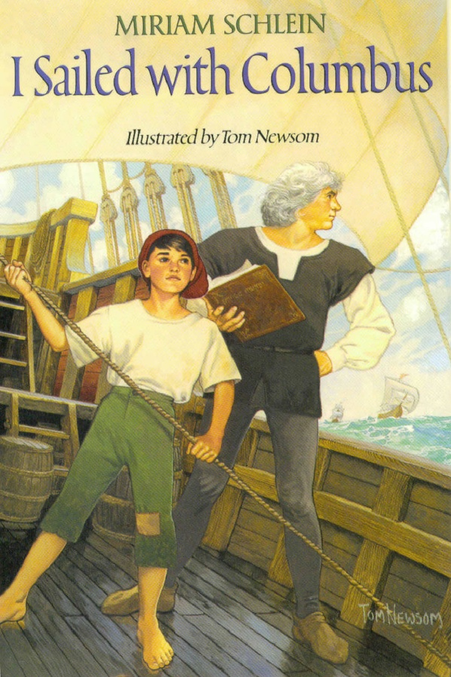
Schlein, Miriam. Illustrated by Tom Newsom. I sailed with Columbus. Illustrated by Tom Newsom. NY: HarperCollins Publishers, 1991.
Summary: Written in journal format by a twelve-year-old ship’s boy, the entries describe Columbus' first voyage of discovery. Setting: Canary Islands, Atlantic Ocean, 1492 A Sampling of Library of Congress Resources:
1492: An Ongoing Voyage
http://www.loc.gov/exhibits/1492/
Images of Christopher Columbus
http://www.loc.gov/pictures/resource/pga.02023/
Today in History (October 12)
http://memory.loc.gov/ammem/today/oct12.html
Columbus’ Coat of Arms
http://www.loc.gov/exhibits/1492/columbus.html
Christopher Columbus Saw Land
http://www.loc.gov/rr/print/list/080_columbus.html
A Letter of Christopher Columbus
http://memory.loc.gov/cgi-bin/query/r?intldl/esbib:@field(NUMBER+@od1(rbesp+0001_0015))

Slide 18
Summary: When their father invites a mail-order bride to come live with them in their prairie home, Caleb and Anna are captivated by their new mother and hope that she will stay.
Setting: Midwestern state, prairie, late 1800s A Sampling of Library of Congress Resources:
Northern Great Plains Collection
http://memory.loc.gov/ammem/award97/ndfahtml/ngphome.html
Prairie Settlement Collection
http://memory.loc.gov/ammem/award98/nbhihtml/pshome.html
Women Pioneers: Westward
http://www.loc.gov/teachers/classroommaterials/presentationsandactivities/presentations/women-pioneers/index.html
Journeys West Lesson Plan
http://www.loc.gov/teachers/classroommaterials/lessons/journeys/
MacLachlan, Patricia. Sarah, Plain and Tall. NY: Harper and Row, 1985

Slide 19
Summary: Sixteen-year-old Margaret Rose Nolan, newly arrived from Ireland, finds work at New York City's Triangle Shirtwaist Factory shortly before the 1911 fire in which 146 employees died.
Setting: New York City, 1911
A Sampling of Library of Congress Resources:
Immigration to the United States
http://www.loc.gov/teachers/classroommaterials/presentationsandactivities/presentations/timeline/riseind/immgnts/
Immigration Challenges for New Americans
http://www.loc.gov/teachers/classroommaterials/primarysourcesets/immigration/
Ellis Island Images
http://www.loc.gov/rr/print/list/070_immi.html
Statue of Liberty Images
http://www.loc.gov/rr/print/list/077_stat.html
Triangle Shirtwaist Factory Fire
http://www.loc.gov/rr/news/topics/triangle.html
Auch, Mary Jane. Ashes of Roses. NY: H. Holt, 2002.

Slide 20
Resources
Library of Congress Professional Development Builder Book Backdrops http://www.loc.gov/teachers/professionaldevelopment/tpsdirect/pdplanbuilder/pdf/Book-Backdrops.pdf
Online version of Mr. Lincoln’s Whiskers written and illustrated by Karen Winnik http://foreverlearning.wikispaces.com/file/view/mrLincolnsWhiskers.pdf
Audio of Karen Winnik reading Grace Bedell’s letter http://www.karenbwinnick.com/audio/lincoln.mp3
Library of Congress website http://www.loc.gov/index.html

